Slide 1





Prediction
Competition
Carter Spence, Matthew Hubbard,
Jack Durrett, Thacker Lively

Slide 2
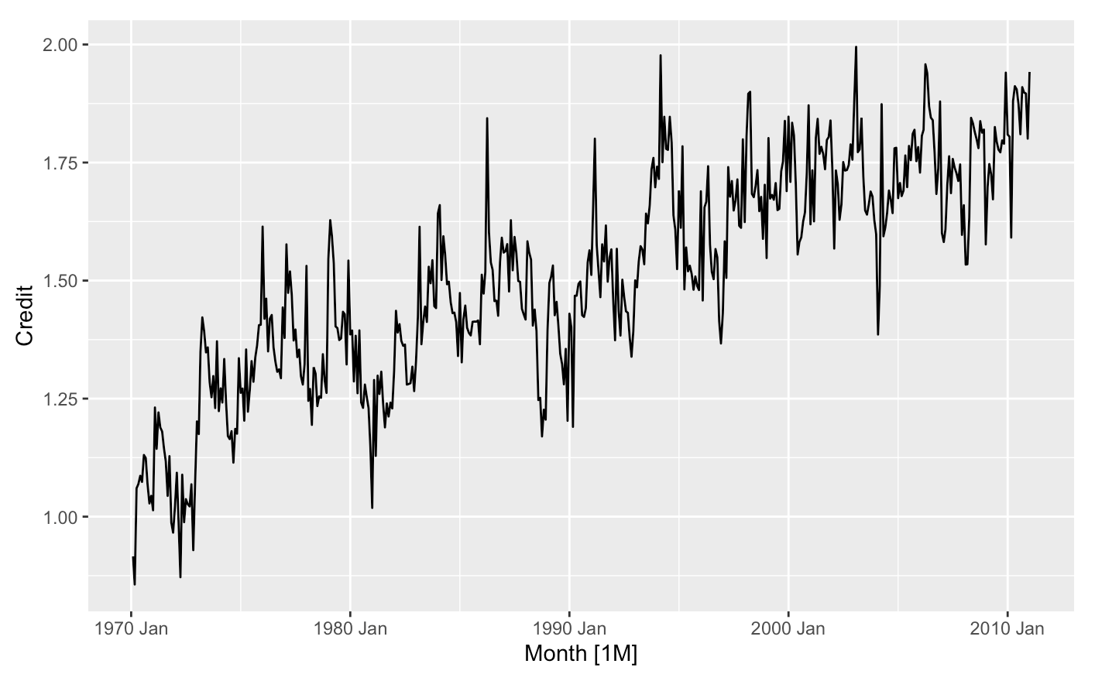
For Starters
Load credit.csv into R
Take the data frame and turn it into a tsibble
Plot the data to see what we are working with

Slide 3
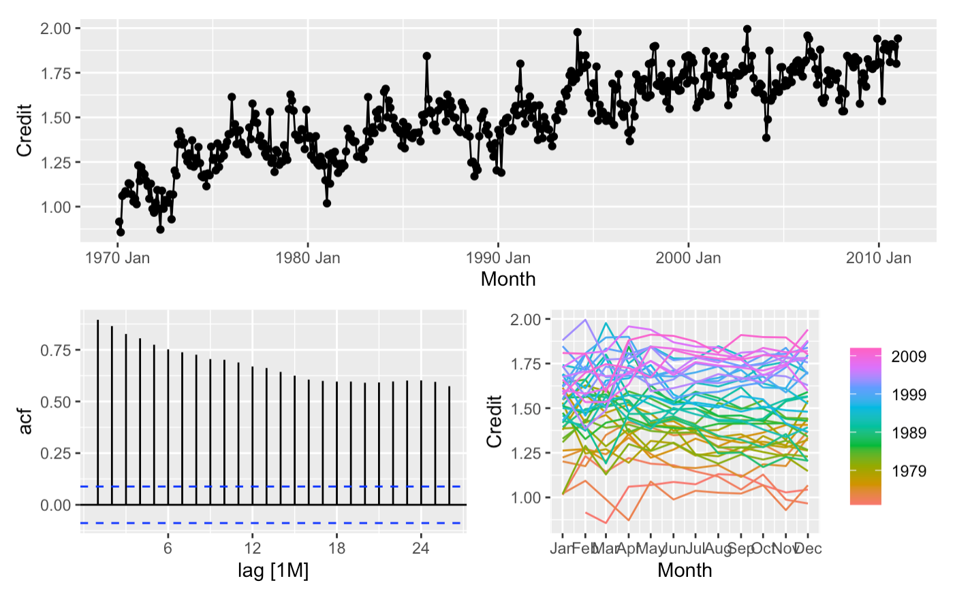
Analyzing Original Data
We see that there is a lot of correlation between months and credit levels
We can tell this based on the way the acf is decreasing at what looks to be a constant rate
We can also tell this based on the way that the residuals are so spread out and not straight
Therefore, we need to run a transformation on this data

Slide 4
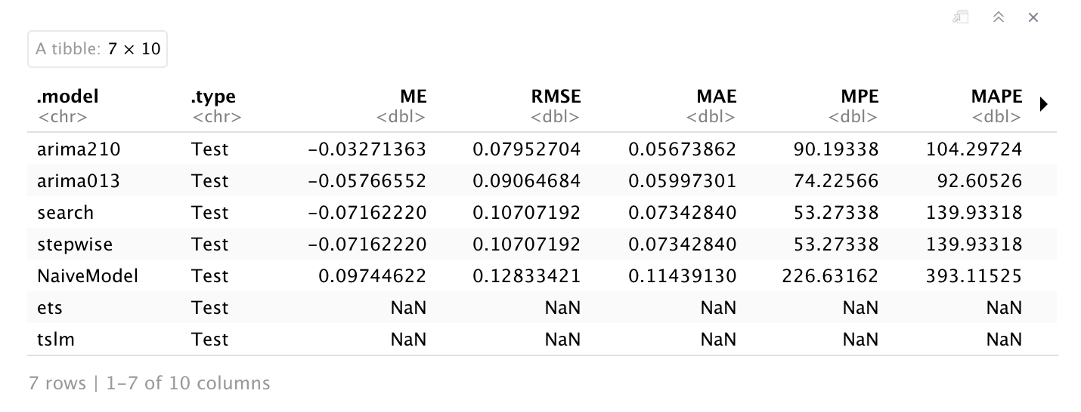
Up Next
After seeing the data plotted, we decided to transform the time series data with a box cox transformation and a seasonal differencing with a lag of 12.
Our team then create our train and holdout data up until May 2007 and after May 2007
Then, we decided to run our train data and see which model reports the lowest RMSE, which was our arima210 model

Slide 5
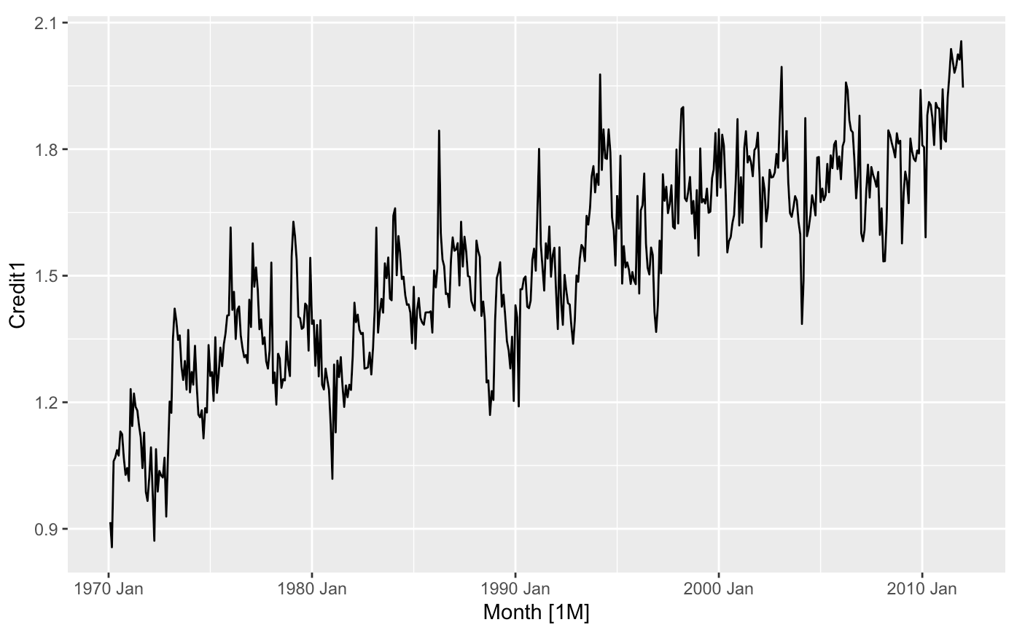
Predicting The Future
When we found our model that best fits our data, we needed to predict 12 periods into the future
After predicting the next 12 periods, we then needed to add it onto our data
Now that it is added on, we can plot our original data with our predictions

Slide 6
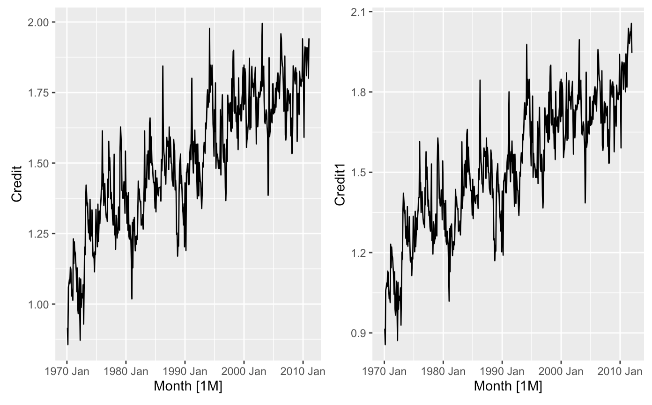
Old vs. New
As you can tell there is an extended piece to our time series data when plotted
Top Right of the right plot
You can see that this added piece looks to follow the same pattern as our original plot
The predicted data is the best we have due to its low RMSE
Therefore, we predict that the upcoming periods will follow the same pattern as the periods before
With our RMSE we believe that we are roughly 92.05% confident that our predicted data will be correct over the next twelve periods

Slide 7
Why Use A Time Series Model?
We use a time series model because we are studying a sequence of data points spaced out over time
In our case, we are analyzing the Imperial Empire’s monthly credit
Our task is to accurately predict the next twelve periods
To do this, we need to study past trends assuming that future trends will follow the same pattern
To find the most accurate model, we analyze a series of them and find the one with the lowest RMSE
RMSE is the standard deviation of residuals, or the typical miss of the model
The model we chose had a RMSE of about .07593 or about 7.593%
Therefore, our model we built will miss about 7.593% when predicting the future monthly credit points

Slide 8


